Slide 1


Amazon Price Optimiser
A project by Kieran Thakkar

Slide 2
Why is my Amazon listing making minimal sales + not on the first-page?

Slide 3
The price!
(That’s where we come in…)

Slide 4
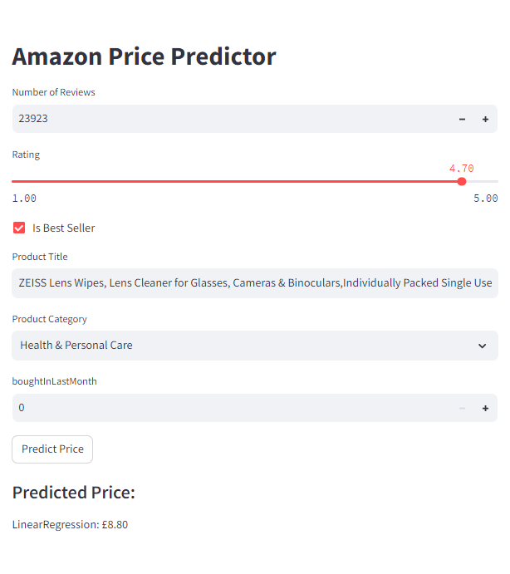
The Amazon Price Optimiser app can find the optimal price to INCREASE SALES

Slide 5

Meet Marcos.
He recently opened an Amazon store.
His listings are getting views but he is finding it hard to bring in sales.

Slide 6

Improper pricing hurt business and left Marco’s future on the line.

Slide 7

Then, Marcos discovered the Amazon Price Optimiser
Now he’s rich and happy.

Slide 8
It’s no surprise Marcos uses the Amazon Price Optimiser regularly.
It uses data scraped from 2.2 million Amazon listings.

Slide 9
Data
Titles
Categories
String

Slide 10
Data
Titles
Categories
Prices
Ratings
Monthly sales
No. Reviews
String
Numerical

Slide 11
Data
Titles
Categories
Prices
Ratings
Monthly sales
No. Reviews
Bestseller status
String
Numerical
Boolean

Slide 12
Processed Data
Titles
Categories
Prices
Ratings
Monthly sales
No. Reviews
Bestseller status
Numerical
Notes:
With some tech magic, all data is converted into numerical to train the model

Slide 13
Processed Data
Titles
Categories
Prices
Ratings
Monthly sales
No. Reviews
Bestseller status
Numerical
Notes:
Method. How does it work?
Trained on highly rated products with good sales. These products have optimised price and we want to price accordingly.
Price had little correlation with data except for the title and rating.

Slide 14
Processed Data
Titles
Categories
Notes:
Method. How does it work?
Trained on highly rated products with good sales. These products have optimised price and we want to price accordingly.
Price had little correlation with data except for the title and rating.

Slide 15
Accuracy
Speed
Balanced
Accuracy
Overfitting
Inaccurate
Title (words) -> numbers
↓WORDS
↓NUMBERS
↑WORDS
↑NUMBERS
Okay accuracy High computation speed
Balance between accuracy and computation speed
High accuracy Low computation speed
Notes:
Ultimately, we found the accuracy of the model, that is how well it could predict the price, was dependant on how it assimilated the title.
To strike a balance between accuracy and computation time

Slide 16
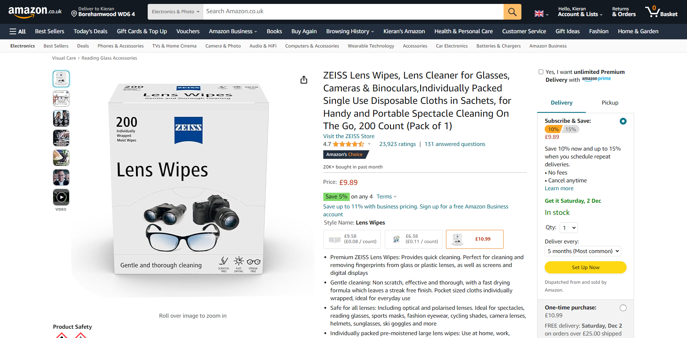

Slide 17
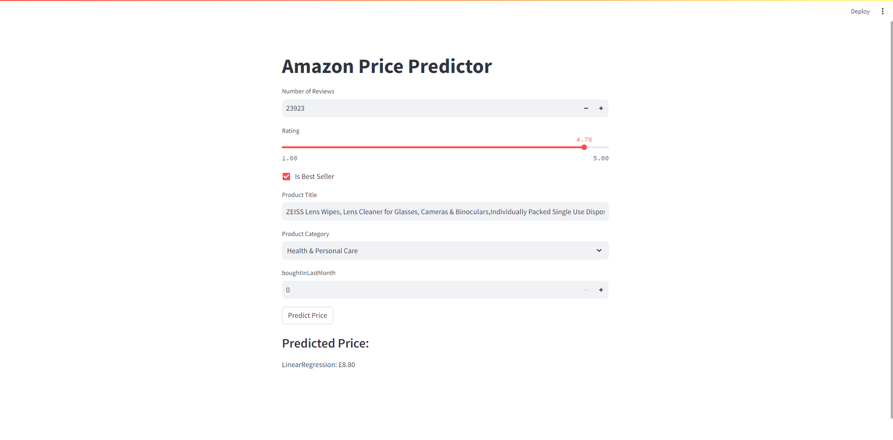

Slide 18
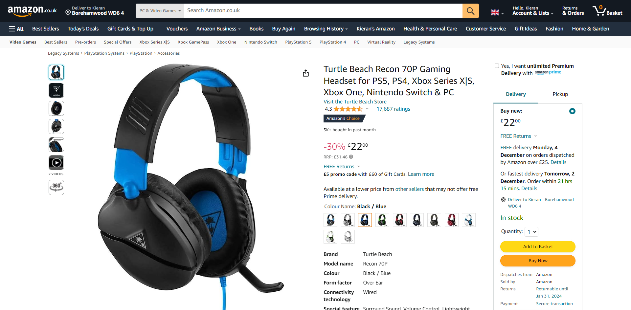

Slide 19
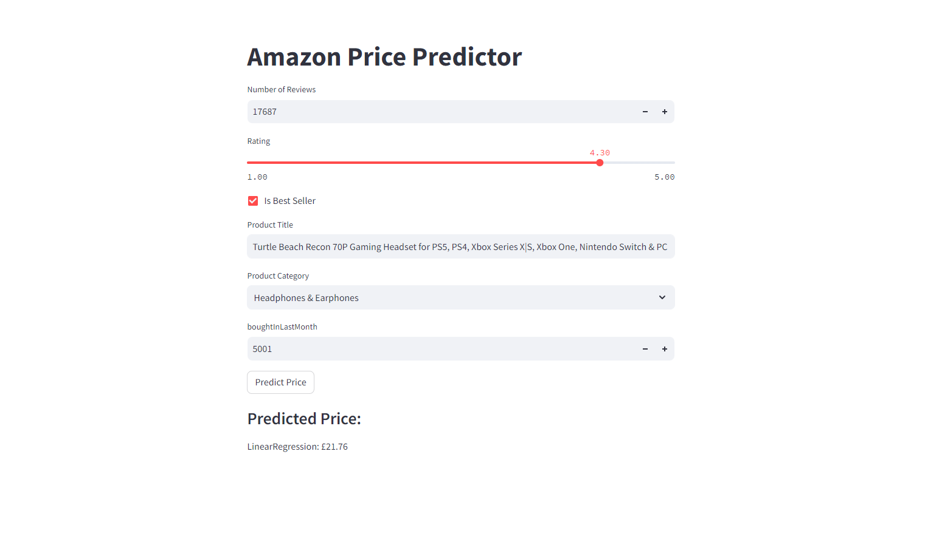

Slide 20


Limitations
Despite the amazing examples, there still exists 2 main limitations on the model.
Number of words, n Only n words are used from the title, resulting in lost information, and potentially affecting the results.
Computation power Higher accuracy requires greater computing power. Even model choice is power-limited.

Slide 21
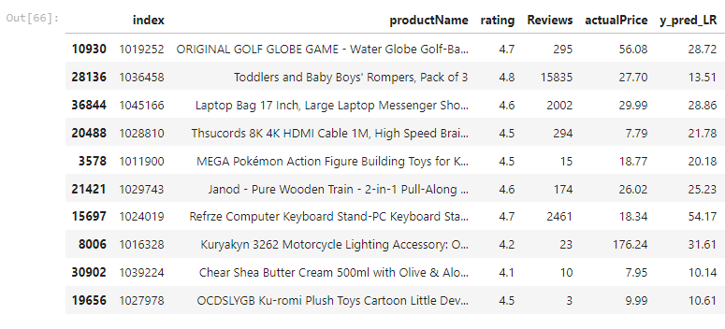

Slide 22
Recommendations
Alternative regression models Higher priced items tend to work better with the Elastic Net model. Prices are rarely high.
Group like categories Each category is given a column and assigned (0/1), grouping categories should aid the model.

Slide 23
THANKS
FOR
WATCHING

